Slide 1
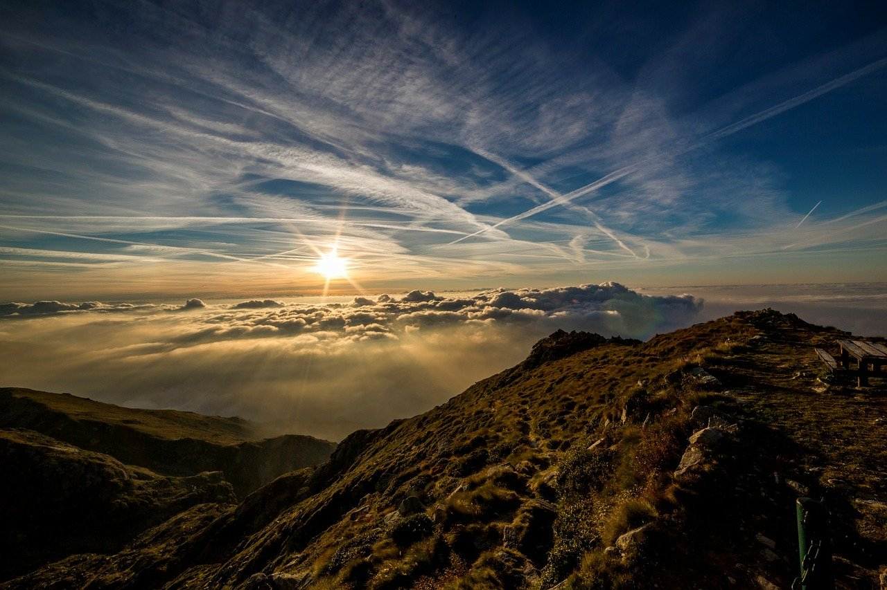
I believe in God,
the Creator!
Maker of everything –
seen and unseen
Supreme over all things
Loving, forgiving,
faithful and just.

Slide 2
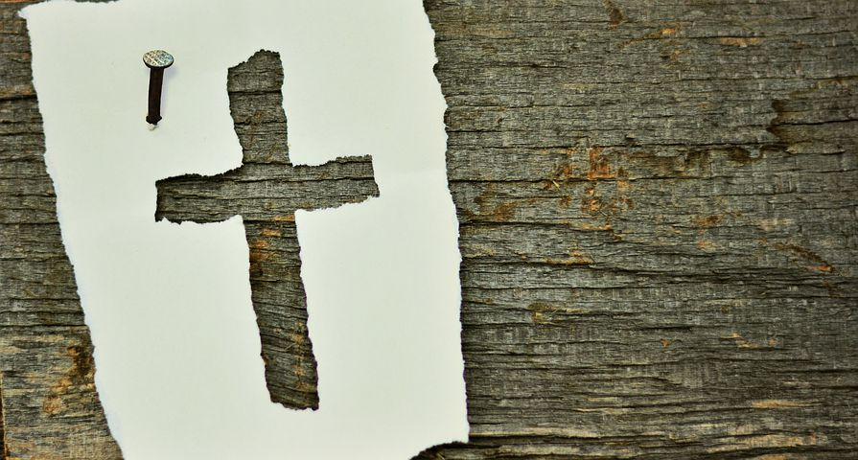
I believe in Jesus Christ!
Born into the world
Crucified for our sakes
Raised again from the dead
Saviour of all who turn to him.

Slide 3
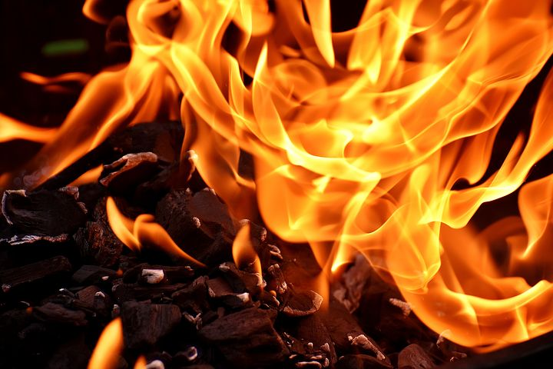
I believe in the Holy Spirit!
Who convicts us of our sin,
Who leads us to Christ,
Who assures us of our salvation
Who equips us to serve in
God’s mission to the world.

Slide 4
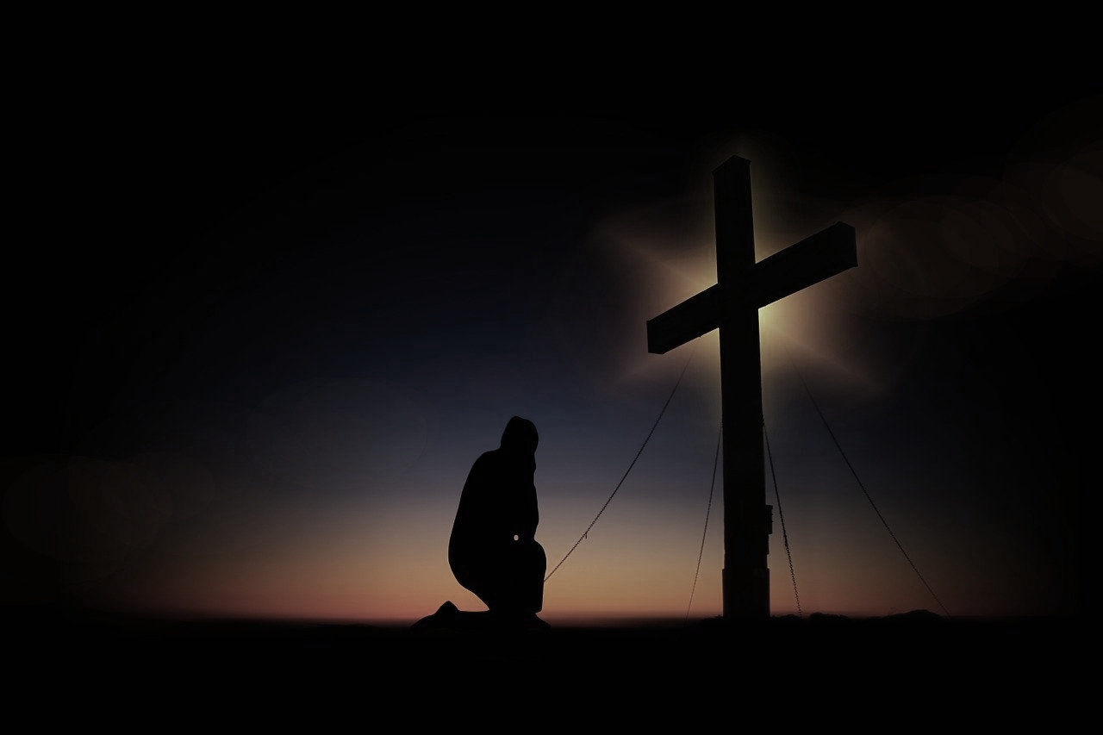

Slide 5
We gather – and you are here
Though unseen, you have been watching over us
Every hour, day and night.
You know our hopes and dreams
Our fears and anxieties
Our disappointments with ourselves,
with others and towards you.
~

Slide 6
Forgive us …
Where we have drawn back
from trusting you fully
Where we have thought badly of you,
ourselves and of others
Where, through fear, we have kept things hidden in the shadows.

Slide 7
We turn towards you
We embrace your forgiveness and grace
Empower us again to step out
from the slavery of our past,
And from the slavery of the culture
in which we live.

Slide 8
Fill us again with your Holy Spirit
And teach us to hate the sins
from which you have delivered us
All-seeing and ever-present,
Gracious and forgiving
Almighty and powerful God
We thank you
and worship you together
Amen

Slide 9
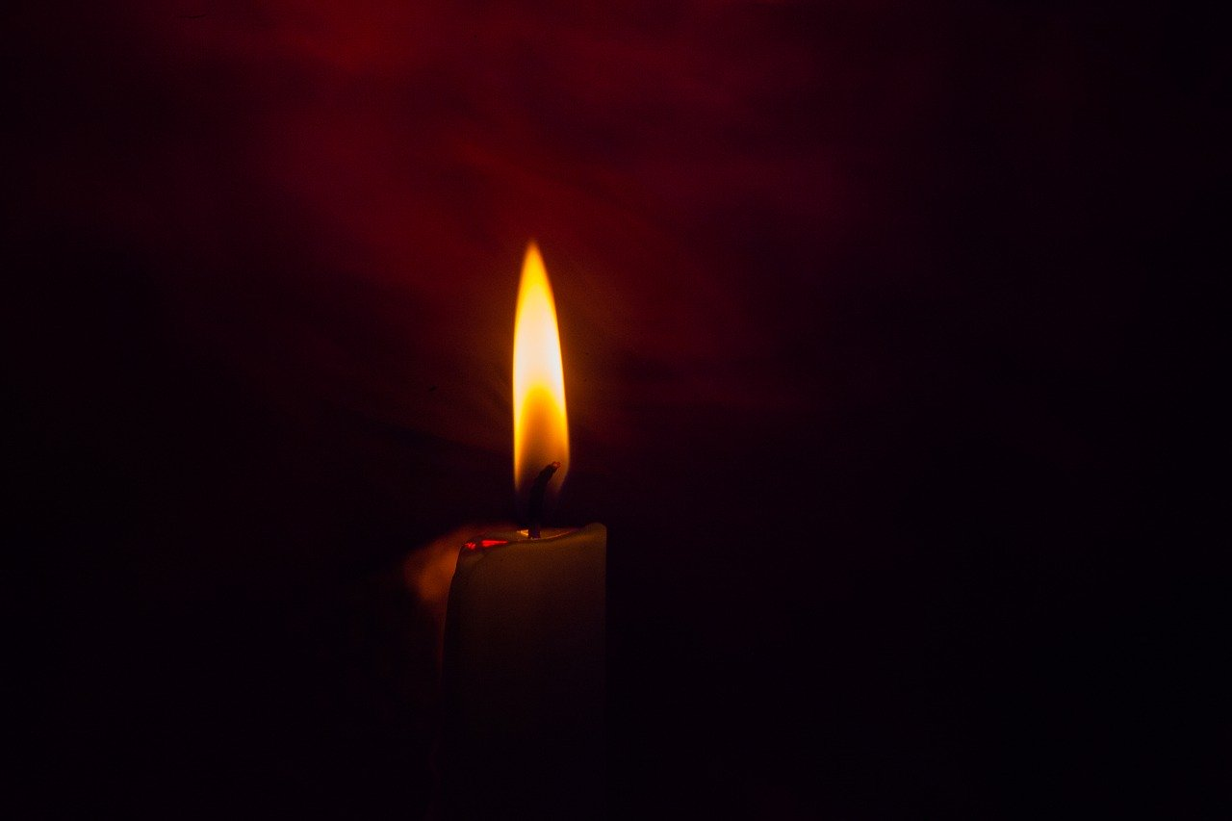
Lord, as Daniel prayed on behalf of Jerusalem and Judah, confessing their sins, we too come before you to confess the sins of Bristol and the UK.

Slide 10
Lord, Bristol and the UK have sinned and done wrong.
We have turned away from your commands and laws.
We have been unfaithful.
And disaster has come upon us with Covid 19.

Slide 11
O Lord, turn away your anger and your wrath from Bristol and the UK.
Hear the prayers and petitions of your servants. We do not ask because we are righteous but because of your great mercy.

Slide 12
O Lord, listen!
O Lord, forgive!
O Lord, hear and act!
Do not delay!
In the name of Jesus, Amen.

Slide 13
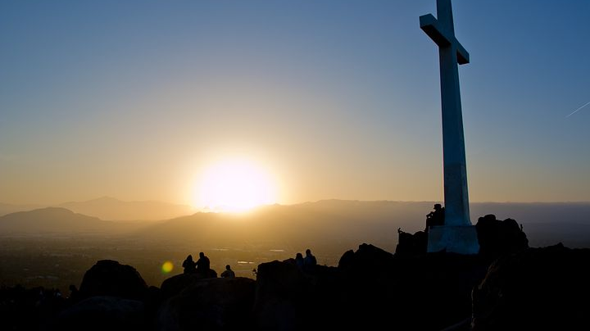

Slide 14
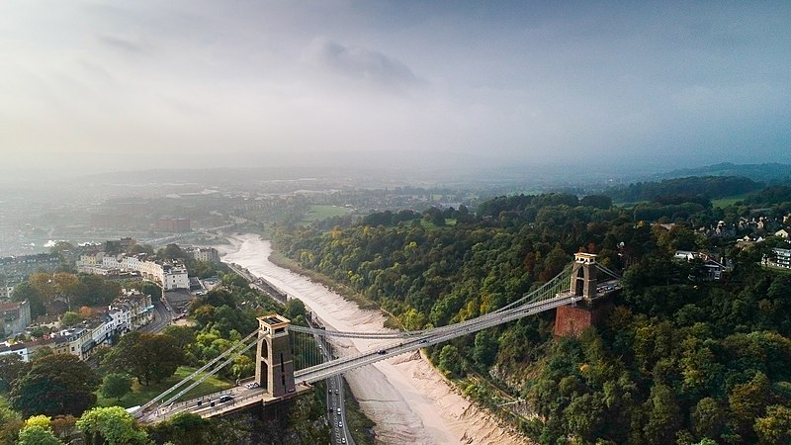
We stand in the mighty name of Jesus
and bless you, Bristol.
That you might prosper under the mighty hand of God.

Slide 15
We bless you that justice and righteousness might take their proper place within your boundaries.
We bless you that the favour of the Lord might rest upon you and give you peace.

Slide 16
We bless you that the Father's compassion might fall upon your people.
We bless your poor that they might be lifted up.

Slide 17
We bless you that the knowledge of Jesus might come in amongst you like a flood.
We bless the people of God in Bristol that they might rise up with servant authority and become a people of blessing.

Slide 18
We bless you that the joy of the Lord might be your strength.
Amen.

