Slide 1
A New Home

Slide 2
2 Corinthians 5 v1-5
5 We know that our body—the tent we live in here on earth—will be destroyed. But when that happens, God will have a home for us to live in. It will not be the kind of home people build here. It will be a home in heaven that will continue forever. ² But now we are tired of this body. We want God to give us our heavenly home. ³ It will clothe us and we will not be naked. ⁴ While we live in this tent, we have burdens and so we complain. I don’t mean that we want to remove this tent, but we want to be clothed with our heavenly home. Then this body that dies will be covered with life. ⁵ This is what God himself made us for. And he has given us the Spirit as the first payment to guarantee the life to come.

Slide 3
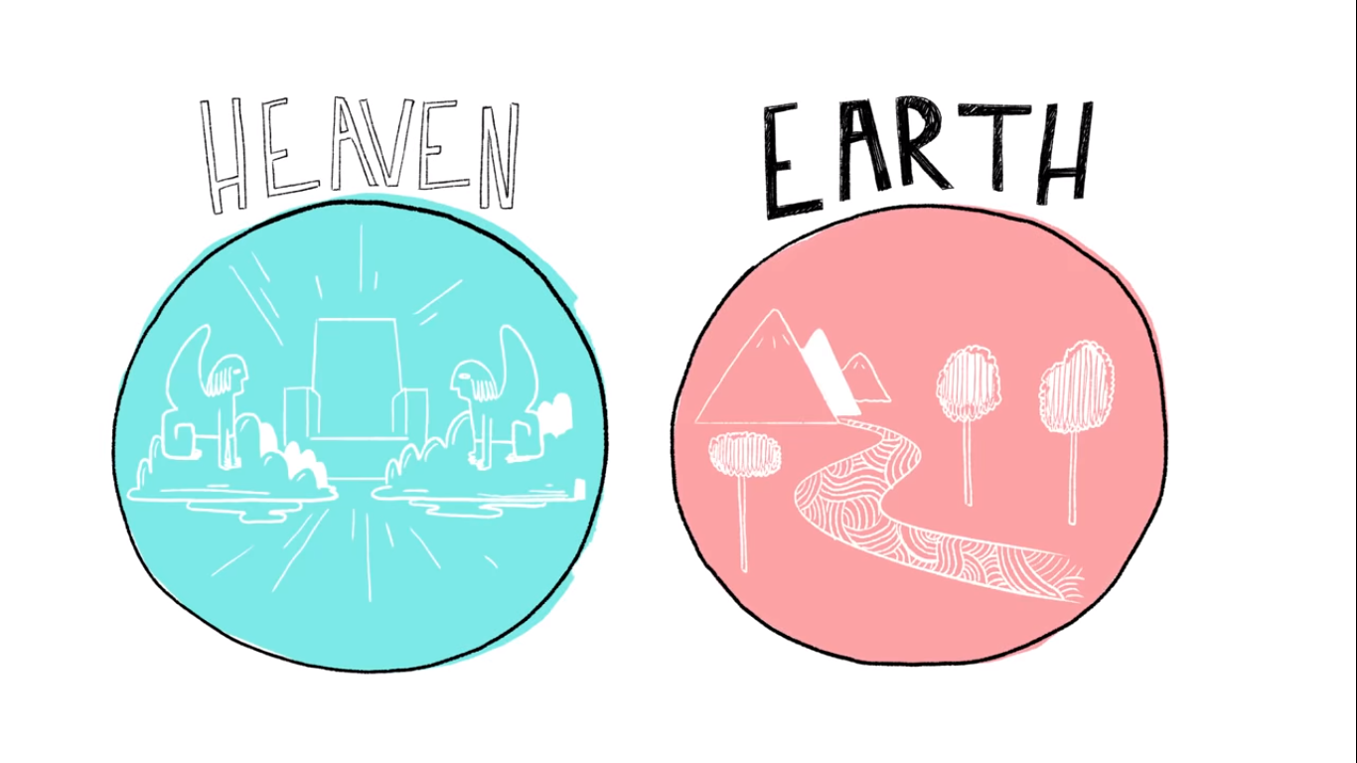

Slide 4


Slide 5


Slide 6
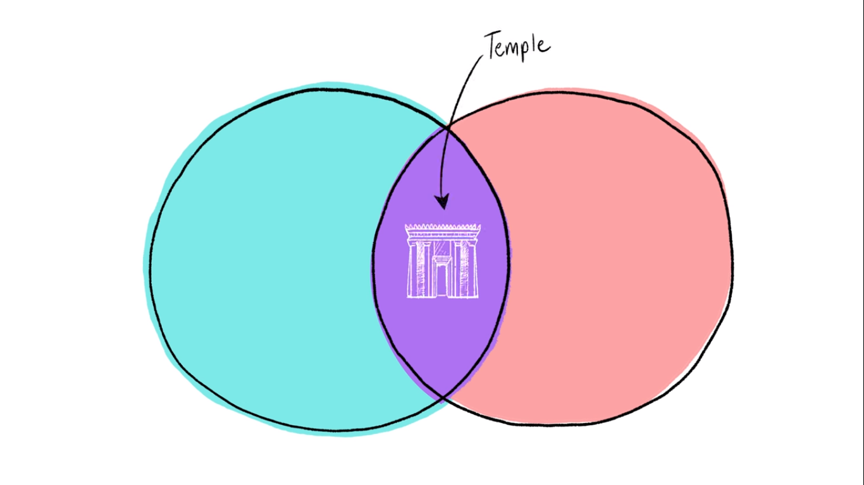

Slide 8
Is there any hope of being home again?

Slide 9
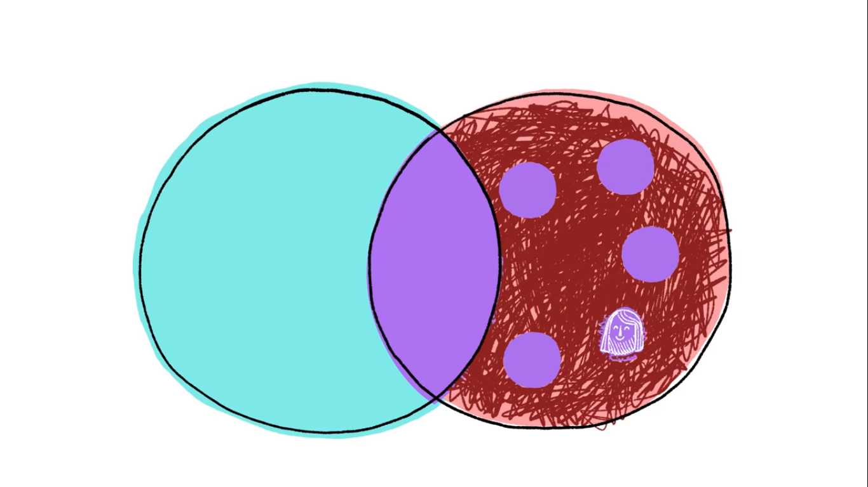

Slide 10
John 14 v1-6
“Don’t let your hearts be troubled. Trust in God, and trust also in me. There is more than enough room in my Father’s home. If this were not so, would I have told you that I am going to prepare a place for you? When everything is ready, I will come and get you, so that you will always be with me where I am. And you know the way to where I am going.”
“No, we don’t know, Lord,” Thomas said. “We have no idea where you are going, so how can we know the way?”
Jesus told him, “I am the way, the truth, and the life. No one can come to the Father except through me.

Slide 11
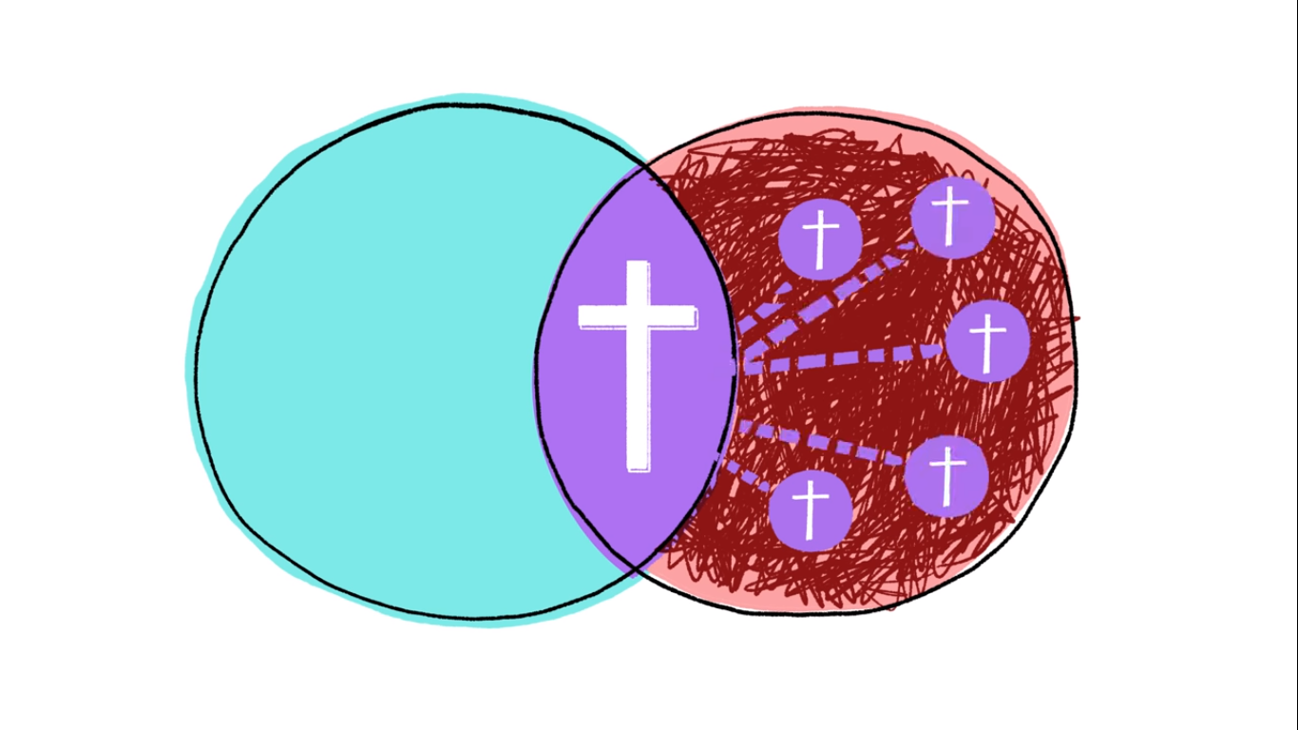

Slide 12
Philippians 3 v20-21
But there’s far more to life for us. We’re citizens of high heaven! We’re waiting the arrival of the Saviour, the Master, Jesus Christ, who will transform our earthy bodies into glorious bodies like his own. He’ll make us beautiful and whole with the same powerful skill by which he is putting everything as it should be, under and around him.

Slide 13


Slide 14
Jeremiah 29 v4-7
This is what the Lord of Heaven’s Armies, the God of Israel, says to all the captives he has exiled to Babylon from Jerusalem: “Build homes, and plan to stay. Plant gardens, and eat the food they produce. Marry and have children. Then find spouses for them so that you may have many grandchildren. Multiply! Do not dwindle away! And work for the peace and prosperity of the city where I sent you into exile. Pray to the Lord for it, for its welfare will determine your welfare.”

Slide 15
What is your Babylon?
What false homes are you building?
Are you resisting, withdrawing, compromising or expressing subversive loyalty?
Where is your ultimate allegiance?
How are you expressing that in your life?

