Slide 1
Comparison is the thief of joy
Galatians 5 v25&26

Slide 2
Since this is the kind of life we have chosen, the life of the Spirit, let us make sure that we do not just hold it as an idea in our heads or a sentiment in our hearts, but work out its implications in every detail of our lives. That means we will not compare ourselves with each other as if one of us were better and another worse. We have far more interesting things to do with our lives. Each of us is an original.
Galatians 5 v 25-6 (MSG)

Slide 3

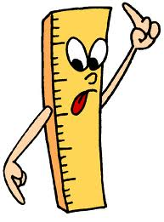
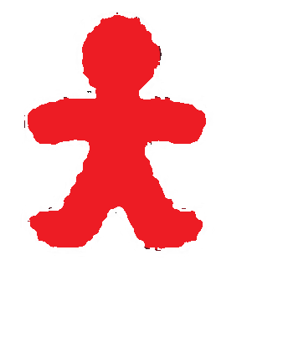
Who we compare
People
Strangers
I
know
ME
VS
Me
as
The old days
I ‘should’ be

Slide 4
Who we compare
ME
VS

Slide 5
Who we compare
VS
US
ME
THEM

Slide 6
What’s behind comparison?
My
generous
Comparison looks at the gap
friend
Inspiration encourages growth
1 Cor 11:1
ME

Slide 7

Mind the gap
Pride
Insecurity& Insignificance
Guilt & Shame
Envy

Slide 8
Avoiding the comparison trap
Made in God’s image (Gen 1:27)
God’s child (John 1:12)
Free from condemnation (Rom 8:1-2)
Bought with a price (1 Cor 6:20)
Redeemed and forgiven (Col 1:14)
Complete in Christ (Col 2:10)
God’s masterpiece (Eph 2:8-10 NLT)
Can approach God with confidence (Eph 3:12)
Read the word
KNOW WHO YOU ARE

Slide 9
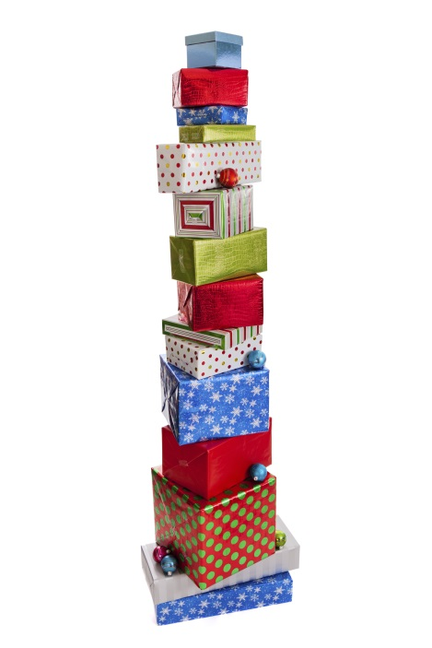


Avoiding the comparison trap
To each one the manifestation of the Spirit is given for the common good (1 Cor 12:7)
Do not neglect your gift (1 Tim 4:14)
Read the word
ME
KNOW WHO YOU ARE
Open your gifts
Let God affirm you

Slide 10
Avoiding the comparison trap
Recognise who others are
Read the word
KNOW WHO YOU ARE
Open your gifts
Let God affirm you

Slide 11
Avoiding the comparison trap
Perfection is about ‘measuring up’
Pursue excellence
Celebrate progress
Being transformed from glory to glory
Encourage one another
PUT AWAY THE MEASURING STICK
Age | Survey
7-10 year olds
11-21 year olds
Cairns
23%
8
61%
22
Be thankful for one another
Don’t pursue perfection
Celebrate successes

Slide 12
Avoiding the comparison trap
Help others to stop
Encourage one another
PUT AWAY THE MEASURING STICK
Be thankful for one another
Don’t pursue perfection
Celebrate successes

Slide 13
Avoiding the comparison trap
You
Culture
BEWARE OF TRIGGERS
People
Social media

Slide 14

The New Me

