Slide 1
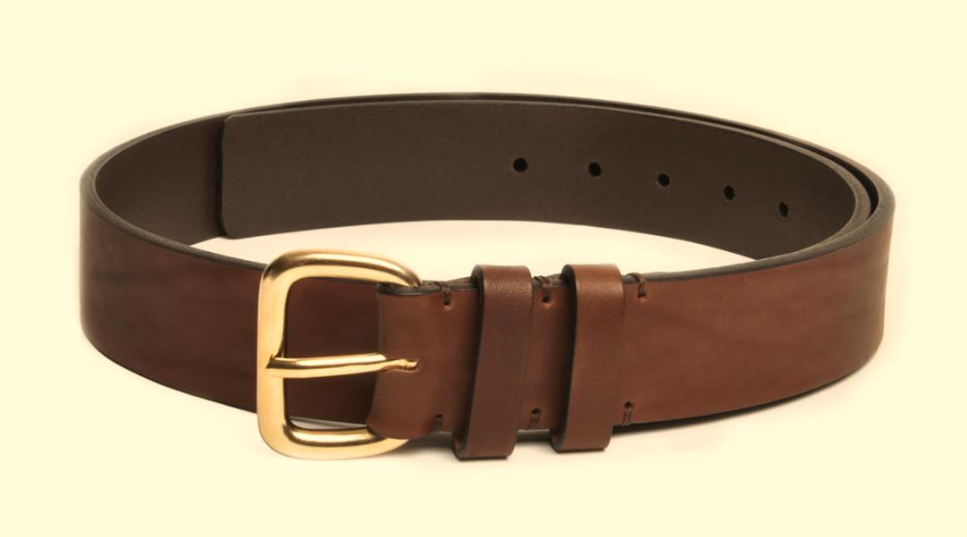
The Belt of Truth

Slide 2

The Belt of Truth

Slide 3
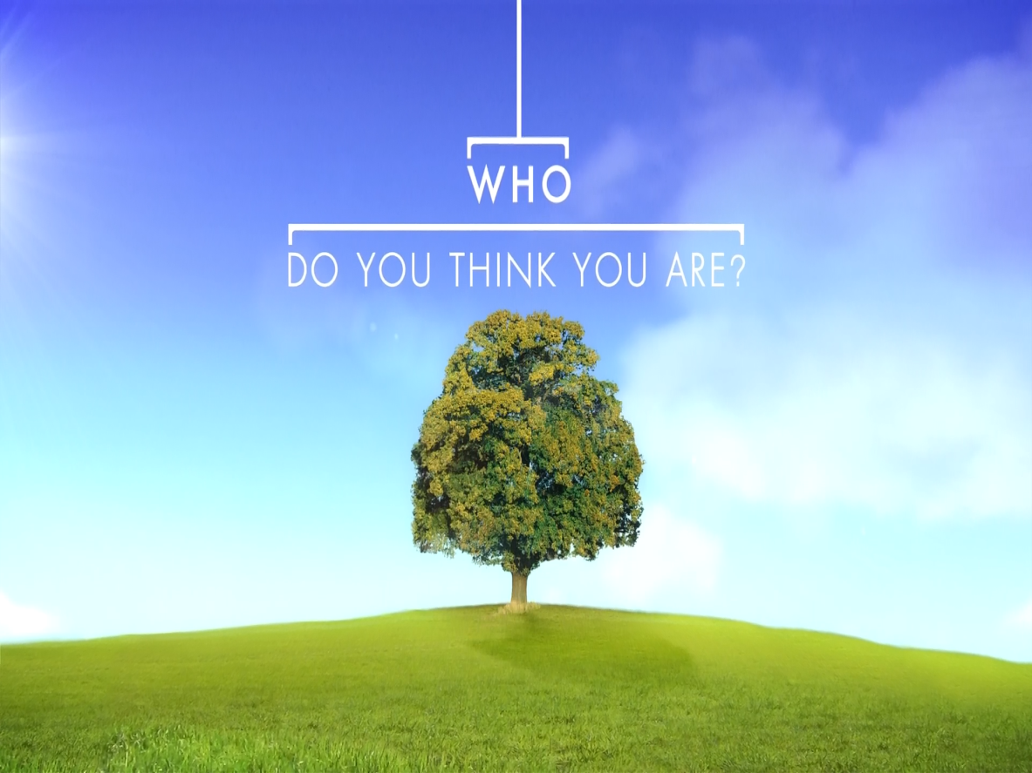
The Belt of Truth

Slide 4
Ephesians 1: 3-23
³ Praise be to the God and Father of our Lord Jesus Christ, who has blessed us in the heavenly realms with every spiritual blessing in Christ. ⁴ For he chose us in him before the creation of the world to be holy and blameless in his sight. In love ⁵ he predestined us to be adopted as his sons through Jesus Christ, in accordance with his pleasure and will – ⁶ to the praise of his glorious grace, which he has freely given us in the One he loves. ⁷ In him we have redemption through his blood, the forgiveness of sins, in accordance with the riches of God’s grace ⁸ that he lavished on us with all wisdom and understanding. ⁹ He made known to us the mystery of his will according to his good pleasure, which he purposed in Christ, ¹⁰ to be put into effect when the times reach their fulfilment – to bring all things in heaven and on earth together under one head, even Christ.

Slide 5
Ephesians 1: 3-23
¹¹ In him we were also chosen, having been predestined according to the plan of him who works out everything in conformity with the purpose of his will, ¹² in order that we, who were the first to hope in Christ, might be for the praise of his glory. ¹³ And you also were included in Christ when you heard the word of truth, the gospel of your salvation. Having believed, you were marked in him with a seal, the promised Holy Spirit, ¹⁴ who is a deposit guaranteeing our inheritance until the redemption of those who are God’s possession – to the praise of his glory.
¹⁵ For this reason, ever since I heard about your faith in the Lord Jesus and your love for all the saints, ¹⁶ I have not stopped giving thanks for you, remembering you in my prayers.

Slide 6
Ephesians 1: 3-23
¹⁷ I keep asking that the God of our Lord Jesus Christ, the glorious Father, may give you the Spirit of wisdom and revelation, so that you may know him better. ¹⁸ I pray that the eyes of your heart may be enlightened in order that you may know the hope to which he has called you, the riches of his glorious inheritance in the saints, ¹⁹ and his incomparably great power for us who believe. That power is like the working of his mighty strength,²⁰ which he exerted when he raised Christ from the dead and seated him at his right hand in the heavenly realms, ²¹ far above all rule and authority, power and dominion, and every title that can be given, not only in the present age but also in the one to come. ²² And God placed all things under his feet and appointed him to be head over everything for the church, ²³ which is his body, the fullness of him who fills everything in every way.

Slide 7
Ephesians 1: Who are we?
Blessed with every spiritual blessing (v3)
In Christ (v3, 4, 7, 11, 13)
Chosen (v4)
Predestined (v5)
Adopted (v5)
Receivers of grace (v6)
Redeemed (v7)
Forgiven (v7)
For the praise of His glory (v12)
Included (v13)
Marked with the Holy Spirit (v13)
Guaranteed an inheritance (v14)

Slide 8
Ephesians 2-3: Who are we?
Made alive (2v5)
Saved (2v5)
Raised with Christ (2v6)
Seated with Christ in the heavenly realms (2v6)
God’s workmanship (2v10)
Brought near (2v13)
Reconciled to God and each other (2v14-16)
Able to approach the Father through the Spirit (2v18)
Fellow citizens (2v19)

Slide 9
Natural & Spiritual
‘In the heavenly realms’
What seems true in the natural is often different to the truth in the spiritual realm
          eg Feeding of the 5000
    Lord’s prayer
        thy kingdom come, thy will be done on earth as in heaven

Slide 10
Truth & Lies
Warring voices
  culture, upbringing, experiences, words spoken by family, friends, colleagues, bosses
The dangers of – “always been”, “not enough” and “too much”
What we believe determines how we behave

Slide 11
Henri Nouwen
“Over the years, I have come to realize that the greatest trap in our life is not success, popularity, or power, but self-rejection. […] As soon as someone accuses me or criticizes me, as soon as I am rejected, left alone, or abandoned, I find myself thinking:
"Well, that proves once again that I am a nobody…I am no good... I deserve to be pushed aside, forgotten,
rejected, and abandoned.”
Self-rejection is the greatest enemy of the spiritual life because it contradicts the sacred voice that calls us the "Beloved." Being the Beloved constitutes the core truth of our existence.”

Slide 12
Ephesians 4:17-24
¹⁷ So I tell you this, and insist on it in the Lord, that you must no longer live as the Gentiles do, in the futility of their thinking. ¹⁸ They are darkened in their understanding and separated from the life of God because of the ignorance that is in them due to the hardening of their hearts. ¹⁹ Having lost all sensitivity, they have given themselves over to sensuality so as to indulge in every kind of impurity, and they are full of greed.
²⁰ That, however, is not the way of life you learned ²¹ when you heard about Christ and were taught in him in accordance with the truth that is in Jesus.²² You were taught, with regard to your former way of life, to put off your old self, which is being corrupted by its deceitful desires; ²³ to be made new in the attitude of your minds; ²⁴ and to put on the new self, created to be like God in true righteousness and holiness.

Slide 13
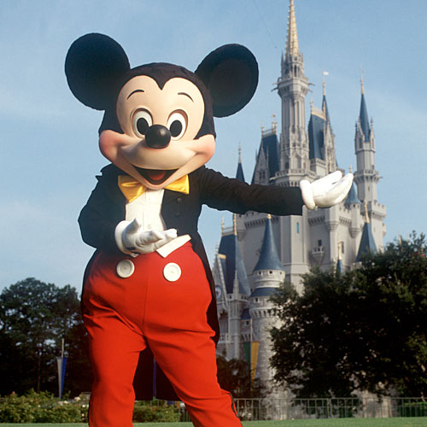
New self or old self?

Slide 14
How do we do it?
Being a wise builder
  Hard work
  Daily decision not a one-off choice
  Not starting new building but renewing old
  Recognise » » » Repent » » » Replace
  Recognise the lie
    Ask God for revelation
    Does it bring life or death?
    Repent
    Replace with the truth

Slide 15
Søren Kierkegaard
“There are two ways to be fooled. One is to believe what isn’t true; the other is to refuse to believe what is true.”

